Slide 1
Chapter 23
Query Processing
Pearson Education © 2014

Slide 2

Chapter 23 – Objectives
Objectives of query processing and optimization.
Static versus dynamic query optimization.
How a query is decomposed and semantically analyzed.
How to apply heuristic transformation rules to improve efficiency of a query.
Pearson Education © 2014

Slide 3
Chapter 23 - Objectives
Types of database statistics required to estimate cost of operations.
Different strategies for implementing selection.
Different strategies for implementing join.
Pearson Education © 2014

Slide 4
Chapter 23 - Objectives
How pipelining can be used to improve efficiency of queries.
Difference between materialization and pipelining.
Approaches to finding optimal execution strategy.
Pearson Education © 2014

Slide 5
Introduction
With declarative languages such as SQL, user specifies what data is required rather than how it is to be retrieved.
Relieves user of knowing what constitutes good execution strategy.
Pearson Education © 2014

Slide 6

Introduction
Also gives DBMS more control over system performance.
Two main techniques for query optimization:
  heuristic rules that order operations in a query;
  comparing different strategies based on relative costs, and selecting one that minimizes resource usage.
Disk access tends to be dominant cost in query processing for centralized DBMS.
Pearson Education © 2014

Slide 7
Query Processing
Activities involved in retrieving data from the database.
Aims of QP:
  transform query written in high-level language (e.g. SQL), into correct and efficient execution strategy expressed in low-level language (implementing RA(Relational Algebra));
  execute strategy to retrieve required data.
Pearson Education © 2014

Slide 8
Query Optimization (QO)
Activity of choosing an efficient execution strategy for processing query.
As there are many equivalent transformations of same high-level query, aim of QO is to choose one that minimizes resource usage.
Generally, reduce total execution time of query.
May also reduce response time of query.
Problem computationally intractable with large number of relations, so strategy adopted is reduced to finding near optimum solution.
Pearson Education © 2014

Slide 9
Example 23.1 - Different Strategies
Find all Managers who work at a London branch.
  SELECT *
  FROM Staff s, Branch b
  WHERE s.branchNo = b.branchNo AND
  (s.position = ‘Manager’ AND b.city = ‘London’);
Pearson Education © 2014

Slide 10
Example 23.1 - Different Strategies
Three equivalent RA queries are:
(1) σ(position='Manager') ∧ (city='London') ∧ (Staff.branchNo=Branch.branchNo) (Staff X Branch)
(2) σ(position='Manager') ∧ (city='London')(
  Staff _{Staff.branchNo=Branch.branchNo} Branch)
(3) (σ_{position='Manager'}(Staff)) _{Staff.branchNo=Branch.branchNo}
  (σ_{city='London'} (Branch))
Pearson Education © 2014

Slide 11
Example 23.1 - Different Strategies
Assume:
  1000 tuples in Staff; 50 tuples in Branch;
  50 Managers; 5 London branches;
  no indexes or sort keys;
  results of any intermediate operations stored on disk;
  cost of the final write is ignored;
  tuples are accessed one at a time.
Pearson Education © 2014

Slide 12
Example 23.1 - Cost Comparison
Cost (in disk accesses) are(do very briefly):
(1) (1000 + 50) + 2*(1000 * 50) = 101 050
(2) 2*1000 + (1000 + 50) = 3 050
1000 + 2*50 + 5 + (50 + 5) = 1 160
(More details in the textbook if you like.)
Cartesian product and join operations much more expensive than selection, and third option significantly reduces size of relations being joined together.
Pearson Education © 2014

Slide 13
Phases of Query Processing
QP has four main phases:
  decomposition (consisting of parsing and validation);
  optimization;
  code generation;
  execution.
Pearson Education © 2014

Slide 14
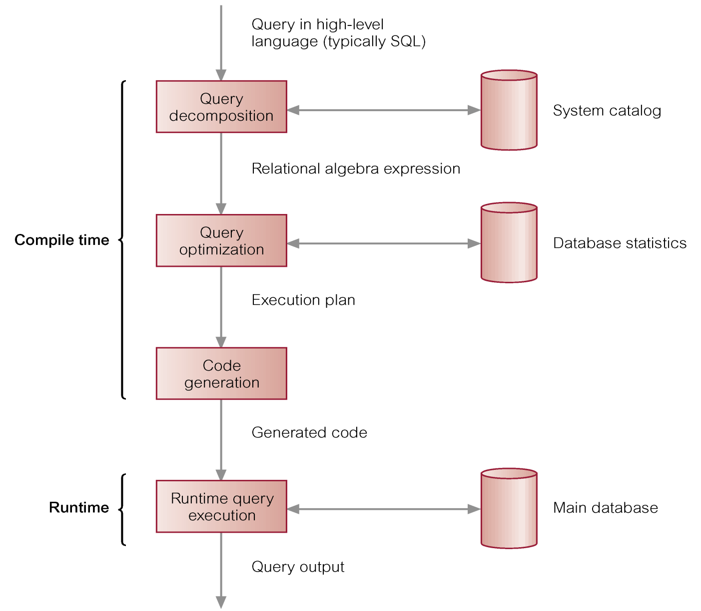
Phases of Query Processing
Pearson Education © 2014

Slide 15
Dynamic versus Static Optimization
Two times when first three phases of QP can be carried out:
  dynamically every time query is run;
  statically when query is first submitted.
Advantages of dynamic QO (Query Optimization) arise from fact that information is up to date.
Disadvantages are that performance of query is affected, time may limit finding optimum strategy.
Pearson Education © 2014

Slide 16
Dynamic versus Static Optimization
Advantages of static QO are removal of runtime overhead, and more time to find optimum strategy.
Disadvantages arise from fact that chosen execution strategy may no longer be optimal when query is run (maybe many rows were added to a table).
Could use a hybrid approach to overcome this (do it dynamically every so often).
Pearson Education © 2014

Slide 17
Query Decomposition
Aims are to transform high-level query into RA (Relational Algebra) query and check that query is syntactically and semantically correct.
Typical stages are:
  analysis,
  normalization,
  semantic analysis,
  simplification,
  query restructuring.
Pearson Education © 2014

Slide 18
Analysis
Analyze query lexically and syntactically using compiler techniques.
Verify relations and attributes exist.
Verify operations are appropriate for object type.
Pearson Education © 2014

Slide 19
Analysis - Example
  SELECT staffNumber
  FROM Staff
  WHERE position > 10;
This query would be rejected on two grounds:
  staffNumber is not defined for Staff relation (should be staffNo).
  Comparison ‘>10’ is incompatible with type position, which is variable character string.
Pearson Education © 2014

Slide 20
Analysis
Finally, query transformed into some internal representation more suitable for processing.
Some kind of query tree is typically chosen, constructed as follows:
  Leaf node created for each base relation.
  Non-leaf node created for each intermediate relation produced by RA operation.
  Root of tree represents query result.
  Sequence is directed from leaves to root.
Pearson Education © 2014

Slide 21
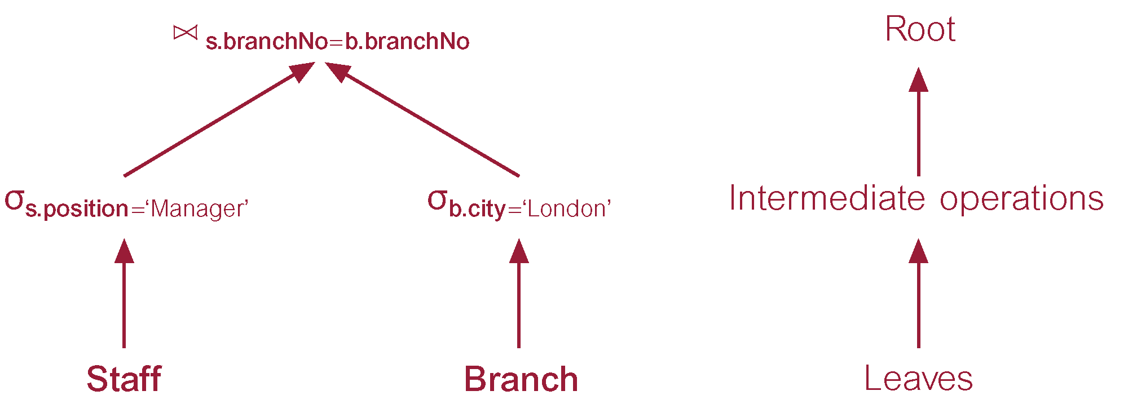
Example 23.1 - R.A.T. (Relational Alg. Tree)
Pearson Education © 2014

Slide 22
Normalization
Converts query into a normalized form for easier manipulation.
Predicate can be converted into one of two forms:
Conjunctive normal form:
  (position = 'Manager' ∨ salary > 20000) ∧ (branchNo = 'B003')
Disjunctive normal form:
  (position = 'Manager' ∧ branchNo = 'B003' ) ∨
  (salary > 20000 ∧ branchNo = 'B003')
Pearson Education © 2014

Slide 23
Semantic Analysis
Rejects normalized queries that are incorrectly formulated or contradictory.
Query is incorrectly formulated if components do not contribute to generation of result.
Query is contradictory if its predicate cannot be satisfied by any tuple.
Algorithms to determine correctness exist only for queries that do not contain disjunction and negation.
Pearson Education © 2014

Slide 24
Simplification
  Detects redundant qualifications,
  eliminates common sub-expressions,
  transforms query to semantically equivalent but more easily and efficiently computed form.
Typically, access restrictions, view definitions, and integrity constraints are considered.
Assuming user has appropriate access privileges, first apply well-known idempotency rules of boolean algebra.
Pearson Education © 2014

Slide 25
  Do Pages 687 (Simplification) – 688 (top)
Pearson Education © 2014

Slide 26
Transformation Rules for RA Operations
Conjunctive Selection operations can cascade into individual Selection operations (and vice versa).
  σ_{p∧q∧r}(R) = σ_{p}(σ_{q}(σ_{r}(R)))
Sometimes referred to as cascade of Selection.
  σ_{branchNo='B003' ∧ salary>15000}(Staff) = σ_{branchNo='B003'}(σ_{salary>15000}(Staff))
Pearson Education © 2014

Slide 27
Transformation Rules for RA Operations
Commutativity of Selection.
  σ_{p}(σ_{q}(R)) = σ_{q}(σ_{p}(R))
For example:
  σ_{branchNo='B003'}(σ_{salary>15000}(Staff)) = σ_{salary>15000}(σ_{branchNo='B003'}(Staff))
Pearson Education © 2014

Slide 28
Transformation Rules for RA Operations
In a sequence of Projection operations, only the last in the sequence is required.
  Π_{L}Π_{M} … Π_{N}(R) = Π_{L} (R)
For example:
  Π_{lName}Π_{branchNo, lName}(Staff) = Π_{lName} (Staff)
Pearson Education © 2014

Slide 29
Transformation Rules for RA Operations
Commutativity of Selection and Projection.
If predicate p involves only attributes in projection list, Selection and Projection operations commute:
  Π_{Ai, …, Am}(σ_{p}(R)) = σ_{p}(Π_{Ai, …, Am}(R)) where p∈ {A₁, A₂, …, A_{m}}
For example:
  Π_{fName, lName}(σ_{lName='Beech'}(Staff)) = σ_{lName='Beech'}(Π_{fName,lName}(Staff))
Pearson Education © 2014

Slide 30
Transformation Rules for RA Operations
Commutativity of Theta join (and Cartesian product).
  R _{p} S = S _{p} R
  R X S = S X R
  (Might need to do this for a later join, switch the tables around, e.g. if have 3 tables, do the smaller join first. )
Rule also applies to Equijoin and Natural join. For example:
  Staff _{staff.branchNo=branch.branchNo} Branch =
  Branch _{staff.branchNo=branch.branchNo} Staff
Pearson Education © 2014

Slide 31
Transformation Rules for RA Operations
Commutativity of Selection and Theta join (or Cartesian product).
If selection predicate involves only attributes of one of join relations, Selection and Join (or Cartesian product) operations commute:
  σ_{p}(R _{r} S) = (σ_{p}(R)) _{r} S
  σ_{p}(R X S) = (σ_{p}(R)) X S
  where p∈ {A₁, A₂, …, A_{n}}
Pearson Education © 2014

Slide 32
Transformation Rules for RA Operations
If selection predicate is conjunctive predicate having form (p ∧ q), where p only involves attributes of R, and q only attributes of S, Selection and Theta join operations commute as:
  σ_{p ∧ q}(R _{r} S) = (σ_{p}(R)) _{r} (σ_{q}(S))
  σ_{p ∧ q}(R X S) = (σ_{p}(R)) X (σ_{q}(S))
Pearson Education © 2014

Slide 33
Transformation Rules for RA Operations
For example:
σposition='Manager' ∧ city='London'(Staff _{Staff.branchNo=Branch.branchNo} Branch) =
  (σ_{position='Manager'}(Staff)) _{Staff.branchNo=Branch.branchNo} (σ_{city='London'} (Branch))
Pearson Education © 2014

Slide 34
Transformation Rules for RA Operations
Commutativity of Projection and Theta join (or Cartesian product).
If projection list is of form L = L₁ ∪ L₂, where L₁ only has attributes of R, and L₂ only has attributes of S, provided join condition only contains attributes of L, Projection and Theta join commute:
  Π_{L1∪L2}(R _{r} S) = (Π_{L1}(R)) _{r} (Π_{L2}(S))
Pearson Education © 2014

Slide 35
Transformation Rules for RA Operations
Commutativity of Union and Intersection (but not set difference).
  R ∪ S = S ∪ R
  R ∩ S = S ∩ R
Pearson Education © 2014

Slide 36
Transformation Rules for RA Operations
Commutativity of Selection and set operations (Union, Intersection, and Set difference).
  σ_{p}(R ∪ S) = σ_{p}(S) ∪ σ_{p}(R)
  σ_{p}(R ∩ S) = σ_{p}(S) ∩ σ_{p}(R)
  σ_{p}(R - S) = σ_{p}(S) - σ_{p}(R)
Pearson Education © 2014

Slide 37
Transformation Rules for RA Operations
Associativity of Theta join (and Cartesian product).
Cartesian product and Natural join are always associative:
  (R S) T = R (S T)
  (R X S) X T = R X (S X T)
Pearson Education © 2014

Slide 38
Heuristical Processing Strategies
(Rules of Thumb (from experience))
Perform Selection operations as early as possible.
  Keep predicates on same relation together.
Combine Cartesian product with subsequent Selection whose predicate represents join condition into a Join operation.
Use associativity of binary operations to rearrange leaf nodes so leaf nodes with most restrictive Selection operations executed first.
Pearson Education © 2014

Slide 39
Heuristical Processing Strategies
Perform Projection as early as possible.
  Keep projection attributes on same relation together.
Compute common expressions once (one example is count).
  If common expression appears more than once, and result is not too large, store result and reuse it when required.
  Useful when querying views, as same expression is used to construct view each time.
Pearson Education © 2014

Slide 40
Cost Estimation for RA Operations
Many different ways of implementing RA operations.
Aim of QO is to choose most efficient one.
Use formulae that estimate costs for a number of options, and select one with lowest cost.
Consider only cost of disk access, which is usually dominant cost in QP (Q. Processing).
Many estimates are based on cardinality of the relation, so need to be able to estimate this.
Pearson Education © 2014

Slide 41
Database Statistics
Success of estimation depends on amount and currency of statistical information DBMS holds.
Keeping statistics current can be problematic.
If statistics updated every time tuple is changed, this would impact performance.
DBMS could update statistics on a periodic basis, for example nightly, or whenever the system is idle.
Pearson Education © 2014

Slide 42
Typical Statistics for Relation R
nTuples(R) - number of tuples in R.
bFactor(R) - blocking factor (number of tuples in a block) of R.
nBlocks(R) - number of blocks required to store R:
  nBlocks(R) = [nTuples(R)/bFactor(R)]
Pearson Education © 2014

Slide 43
Typical Statistics for Attribute A of Relation R
nDistinct_{A}(R) - number of distinct values that appear for attribute A in R.
min_{A}(R), max_{A}(R) - minimum and maximum possible values for attribute A in R.
SC_{A}(R) - selection cardinality of attribute A in R.
  Average number of tuples that satisfy an equality condition on attribute A.
  SC_{A}(R) = 1 if A is a key attribute of R
  SC_{A}(R) = [nTuples(R) / nDistinct_{A} (R)] otherwise
Pearson Education © 2014

Slide 44
Statistics for Multilevel Index I on Attribute A
nLevels_{A}(I) - number of levels in I.
nLfBlocks_{A}(I) - number of leaf blocks in I.
Pearson Education © 2014

Slide 45
Selection Operation
Predicate may be simple or composite.
Number of different implementations, depending on file structure, and whether attribute(s) involved are indexed/hashed.
Main strategies are:
  Linear Search (Unordered file, no index).
  Binary Search (Ordered file, no index).
  Equality on hash key.
  Equality condition on primary key.
Pearson Education © 2014

Slide 46
Selection Operation
  Inequality condition on primary key.
  Equality condition on clustering (secondary) index.
  Equality condition on a non-clustering (secondary) index.
  Inequality condition on a secondary B⁺-tree index.
Pearson Education © 2014

Slide 47
Estimating Cardinality of Selection
Assume attribute values are uniformly distributed within their domain and attributes are independent.
nTuples(S) = SC_{A}(R)
See the textbook - For the Teacher
Pearson Education © 2014

Slide 48
Equality of Hash Key
If attribute A is hash key, apply hashing algorithm to calculate target address for tuple.
If there is no overflow, expected cost is 1.
If there is overflow, additional accesses may be necessary.
Pearson Education © 2014

Slide 49
Equality Condition on Primary Key
Can use primary index to retrieve single record satisfying condition.
Need to read one more block than number of index accesses, equivalent to number of levels in index, so estimated cost is:
  nLevels_{A}(I) + 1
Pearson Education © 2014

Slide 50

Join Operation – Do Quickly
Main strategies for implementing join:
  Block Nested Loop Join.
  Indexed Nested Loop Join.
  Sort-Merge Join.
  Hash Join.
Pearson Education © 2014

Slide 51
Estimating Cardinality of Join
Cardinality of Cartesian product is:
  nTuples(R) * nTuples(S)
More difficult to estimate cardinality of any join as depends on distribution of values.
Worst case, cannot be any greater than this value.
Pearson Education © 2014

Slide 52
Block Nested Loop Join
Simplest join algorithm is nested loop that joins two relations together a tuple at a time.
Outer loop iterates over each tuple in R, and inner loop iterates over each tuple in S.
As basic unit of reading/writing is a disk block, better to have two extra loops that process blocks.
Pearson Education © 2014

Slide 53
Sort-Merge Join
For Equijoins, most efficient join is when both relations are sorted on join attributes.
Can look for qualifying tuples merging relations.
May need to sort relations first.
Now tuples with same join value are in order.
If assume join is *:* and each set of tuples with same join value can be held in database buffer at same time, then each block of each relation need only be read once.
Pearson Education © 2014

Slide 54
Sort-Merge Join
Cost estimate for the sort-merge join is:
  nBlocks(R) + nBlocks(S)
If a relation has to be sorted, R say, add:
  nBlocks(R)*[log₂(nBlocks(R)]
Pearson Education © 2014

Slide 55
Hash Join
For Natural or Equijoin, hash join may be used.
Idea is to partition relations according to some hash function that provides uniformity and randomness.
Each equivalent partition should hold same value for join attributes, although it may hold more than one value.
Pearson Education © 2014

Slide 56
Projection Operation
To implement projection need to:
  remove attributes that are not required;
  eliminate any duplicate tuples produced from previous step. Only required if projection attributes do not include a key.
Two main approaches to eliminating duplicates:
  sorting;
  hashing.
Pearson Education © 2014

Slide 57
Duplicate Elimination using Sorting
Sort tuples of reduced relation using all remaining attributes as sort key.
Duplicates will now be adjacent and can be removed easily.
Pearson Education © 2014

Slide 58
Aggregate Operations
  SELECT AVG(salary)
  FROM Staff;
To implement query, could scan entire Staff relation and maintain running count of number of tuples read and sum of all salaries.
Easy to compute average from these two running counts.
Pearson Education © 2014

Slide 59
Aggregate Operations
  SELECT AVG(salary)
  FROM Staff
  GROUP BY branchNo;
For grouping queries, can use sorting or hashing algorithms similar to duplicate elimination.
Can estimate cardinality of result using estimates derived earlier for selection.
Pearson Education © 2014

Slide 60
Enumeration of Alternative Strategies
Fundamental to efficiency of QO is the search space of possible execution strategies and the enumeration algorithm used to search this space.
Query with 2 joins gives 12 join orderings:
R (S T) R (T S) (S T) R (T S) R
S (R T) S (T R) (R T) S (T R) S
T (R S) T (S R) (R S) T (S R) T
With n relations, (2(n – 1))!/(n – 1)! orderings.
If n = 4 this is 120; if n = 10 this is > 176 billion.
Compounded by various selection/join methods.
Pearson Education © 2014

Slide 61
Pipelining
Materialization - output of one operation is stored in temporary relation for processing by next.
Could also pipeline results of one operation to another without creating temporary relation (can use a buffer in RAM).
Known as pipelining or on-the-fly processing.
Pipelining can save on cost of creating temporary relations and reading results back in again.
Generally, pipeline is implemented as separate process or thread.
Pearson Education © 2014

Slide 62
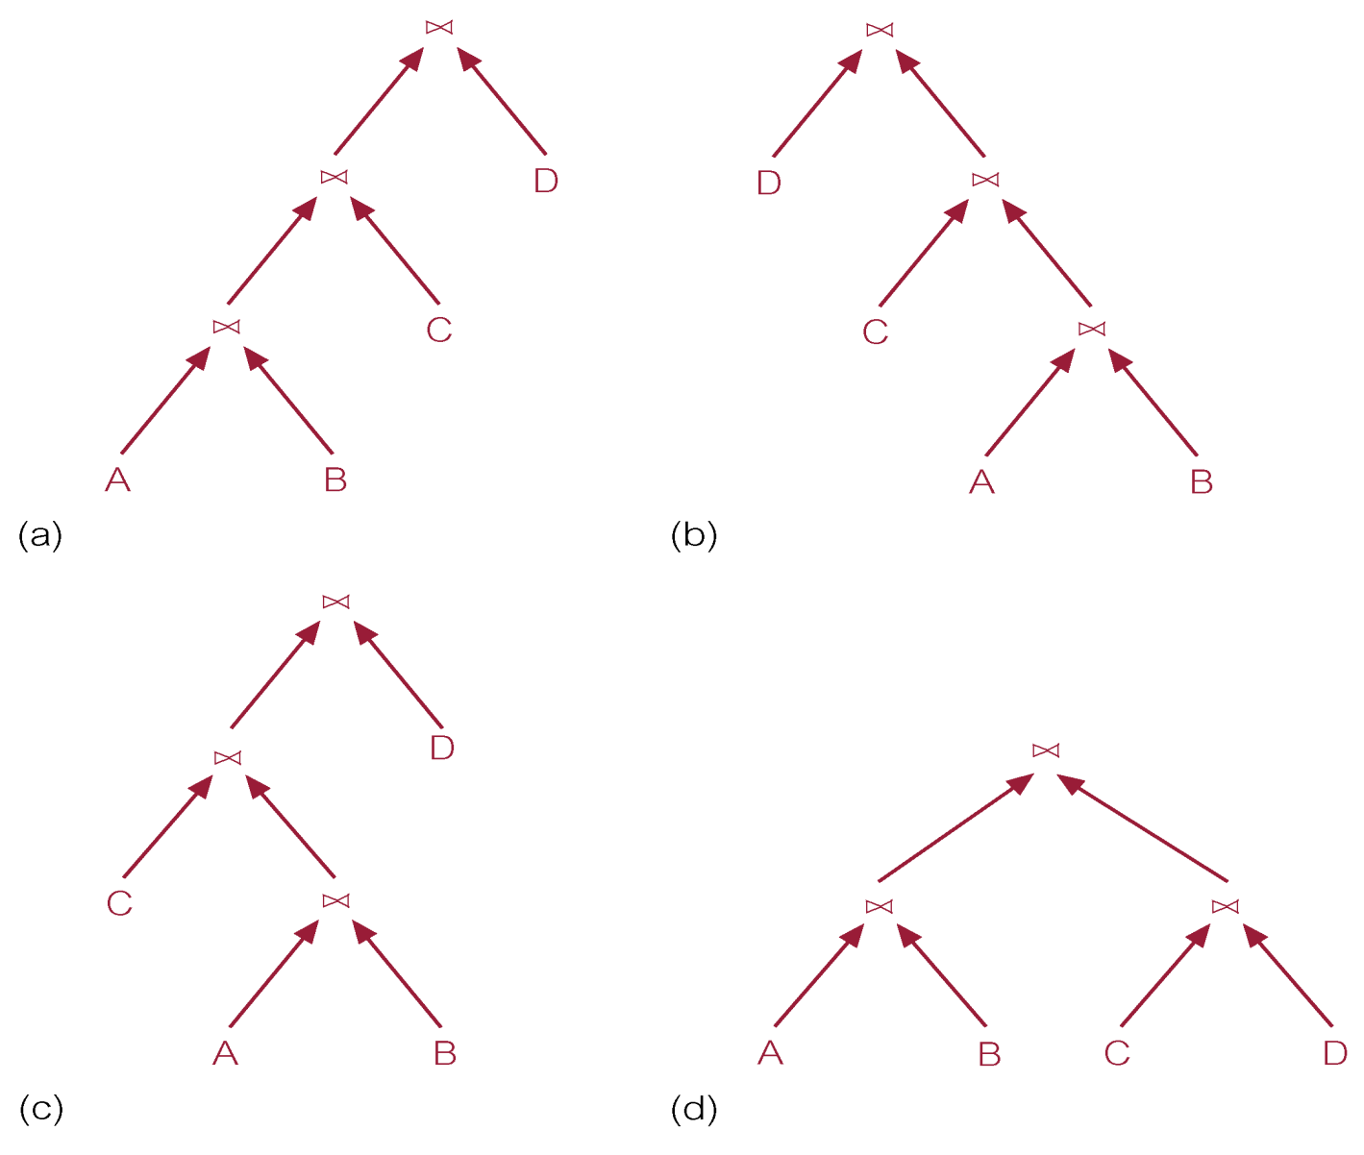
Types of Trees
Pearson Education © 2014

Slide 63
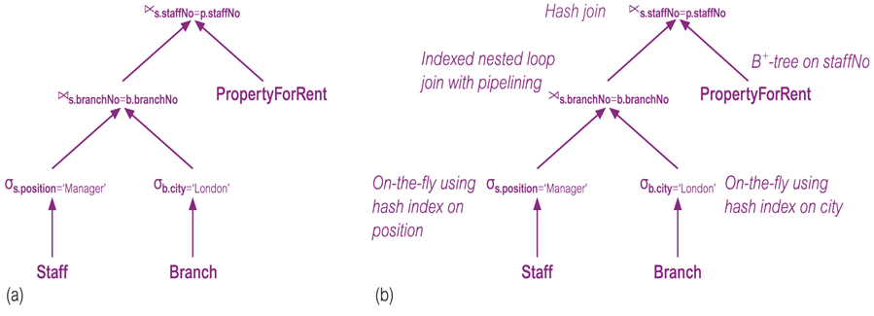
Physical Operators & Strategies
Pearson Education © 2014

Slide 64
Semantic Query Optimization
Based on constraints specified on the database schema to reduce the search space.
For example, a constraint states that staff cannot supervise more than 100 properties, so any query searching for staff who supervise more than 100 properties will produce zero rows. Now consider:
CREATE ASSERTION ManagerSalary
CHECK (salary > 20000 AND position = ‘Manager’)
SELECT s.staffNo, fName, lName, propertyNo
FROM Staff s, PropertyForRent p
WHERE s.staffNo = p.staffNo AND
position = ‘Manager’;
Pearson Education © 2014

Slide 65
Semantic Query Optimization
Can rewrite this query as:
SELECT s.staffNo, fName, lName, propertyNo
FROM Staff s, PropertyForRent p
WHERE s.staffNo = p.staffNo AND
salary > 20000 AND position = ‘Manager’;
Additional predicate may be very useful if only index for Staff is a B+-tree on the salary attribute.
However, additional predicate would complicate query if no such index existed.
Pearson Education © 2014

